Slide 1
it depends… – don’t mistake your Google search for my database experience
Magnus Ahlkvist

Slide 2








sponsors

Slide 3
Any questions so far?
i’ve got one:
What the H$ll kind of font is this dude using??

Slide 5
The cocky know-it-all on stage
Long distance runner
in an overweight and really slow body
20 years database professional
Three to four letter long abbreviations

Slide 6
Session contents
Rants at “Best Practice” ®™
instant file initialization, a free lunch?
Though shalt defragment indexes! Right?!
Developers, try using your brains (for once)

Slide 7
“Maintain functional expertise and knowledge on the latest database technologies including surrounding industry best practices.”
DBA job description

Slide 8
Develop documentation for best practices.
DBA job description

Slide 9
assist in developing best practices for key technologies and products
Premier Field Engineer job description

Slide 10

What the H*ll Does ”Best Practices” mean?

Slide 11
Best practice: defragment your indexes
quiz:
Do you defrag indexes?
How?
Why???!!!

Slide 12
Best practice: instant file initialization
Now default
Do you use it?
Does it hurt your performance?!
Are you sure???!!!

Slide 13
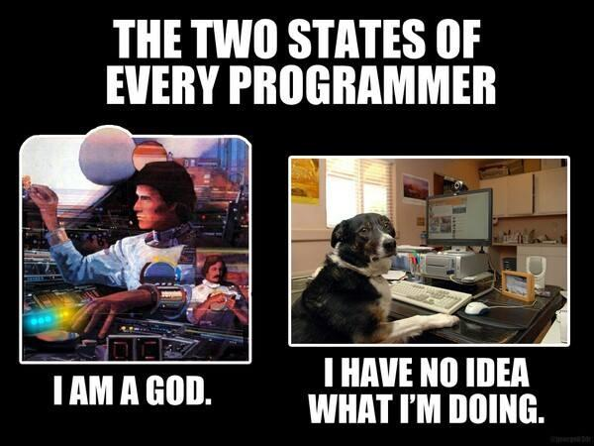

Slide 14
sponsors

